Slide 1
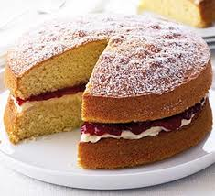
Victoria Sandwich Cake
Recipe
3 eggs
150g / 6oz caster sugar
150g / 6oz self raising flour
150g / 6oz soft margarine
METHOD
Collect equipment
Light oven Gas 5 or 180C
Line the sandwich tins
In the mixing bowl, cream margarine and sugar until light and fluffy
Use knife to break eggs in to the small bowl. Beat with fork (30 seconds)
Beat eggs into the mixture, 1/4 at a time. Then beat for 3 minutes.
Sieve flour onto mixture and fold in carefully using a tablespoon.
Divide mixture between the 2 tins.
Bake for 15—20 minutes until golden and springy to the touch.
Turn onto cooling rack and cool before adding jam.
Equipment
2 sandwich tins
Mixing bowl
Electric whisk
Small bowl
Knife
Table spoon
Sieve
Spatula

