Slide 1
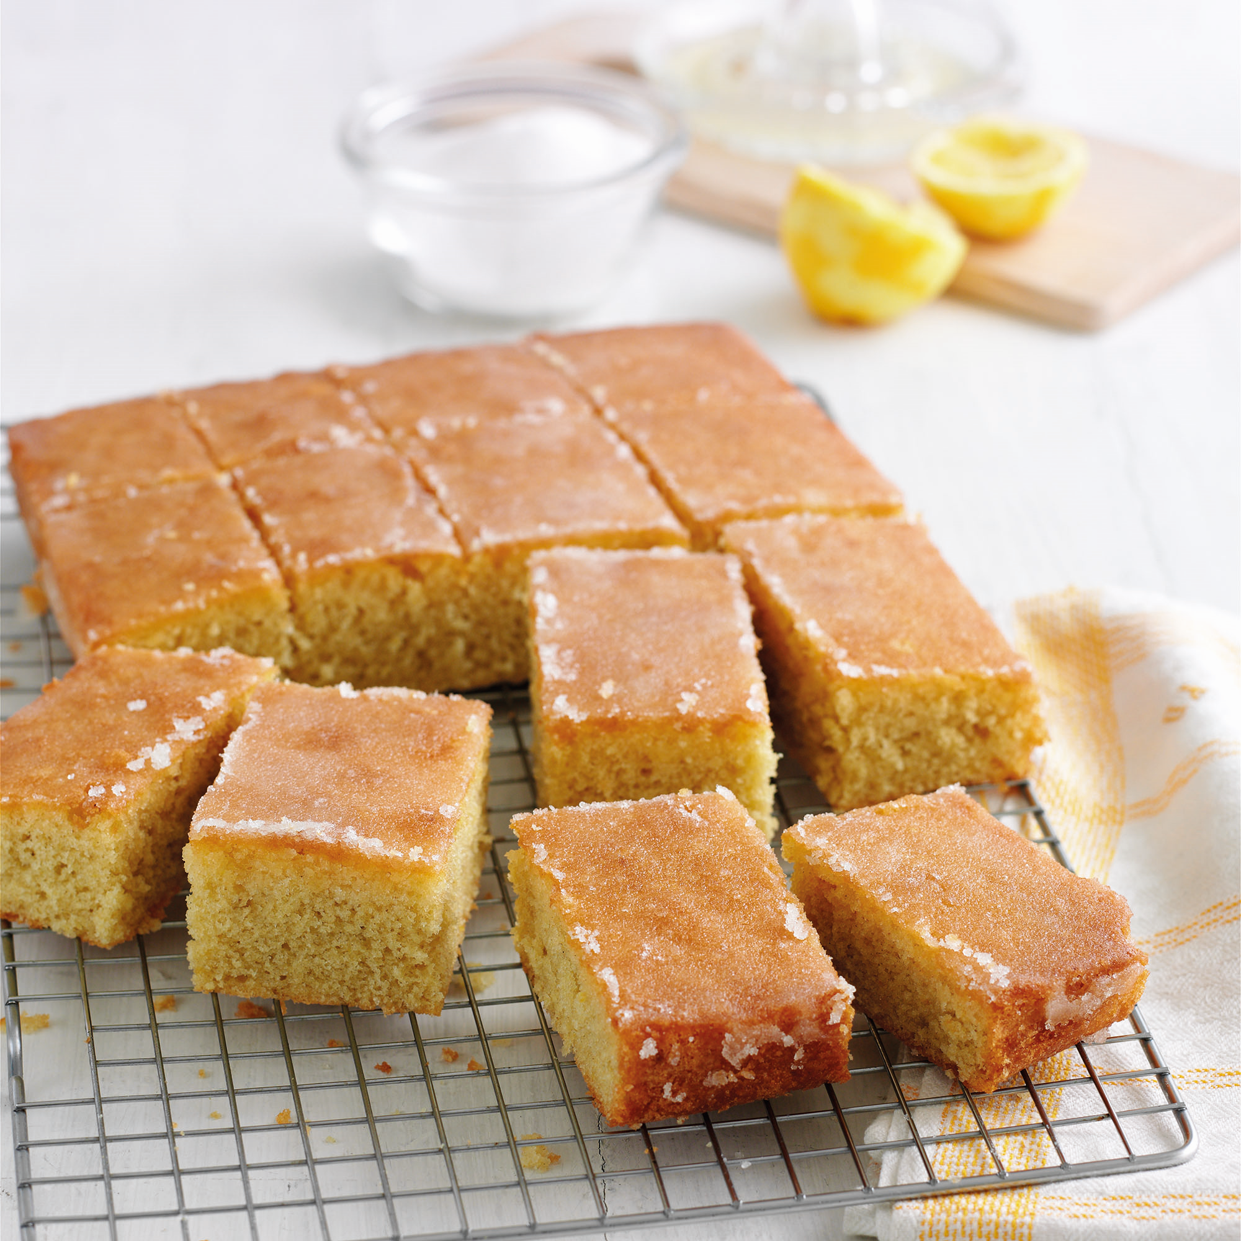
Learning objective ..
Today we are learning how to mix and bake cake ingredients and make a lemon glaze.
Method
Turn oven to 180 degrees C / gas mark 4. Grease and line the tin.
Place butter / margarine, sugar, flour baking powder, eggs, milk and lemon zest into a mixing bowl. Beat until smooth.
Place mixture into tin.
Bake for 30 minutes until risen and springy to the touch.
Make the glaze by mixing the lemon juice with the sugar.
Spoon the glaze over the warn cake and leave to cool.
Wash up and write name label.
Lemon Traybake
100g butter / margarine
100g sugar
120g self rising - flour
½ tsp baking powder (from school)
Splash of milk (from school)
2 eggs
1 lemon – grated zest used in cake a juice used for glaze.
For the glaze
75g sugar
FROM HOME 20cm round or square baking tin
Equipment to get out at school
Chopping board
Vegetable knife
Mixing bowl
Wooden spoon
Zester
Juicer

