Slide 1
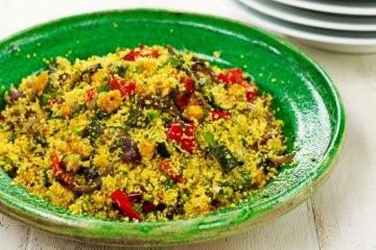
Cous cous & vegetables
Recipe
1 courgette
1 yellow pepper
2 medium tomatoes
1 onion
1 packet of cous cous (any flavour)
1 tin tuna drained (optional)
Container to take dish home in
Method
Collect equipment
Light the oven at gas 7 or 220 degrees C
Make up the cous cous according to the packet instructions.
Chop the vegetables into chunks.
Place the vegetables into a roasting tin and lightly coat in oil (1 tablespoon)
Roast in the oven for 30 minutes until soft.
Combine the vegetables and the cous cous in your container. (with tuna if using)
Wash up.
Equipment to get out at school
Chopping board
Vegetable knife
Measuring jug
Table spoon
Eat hot or cold. Think about adding other ingredients such as sun dried tomatoes, toasted pine nuts, fresh basil.

