Slide 1
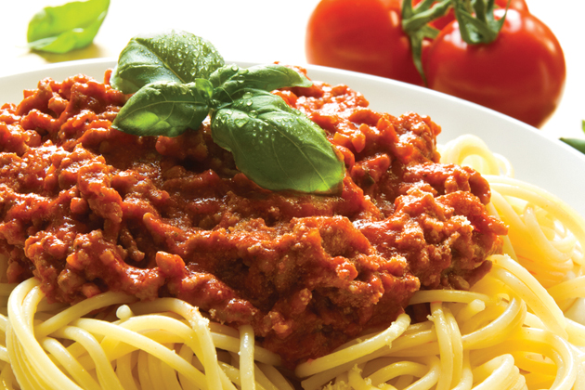
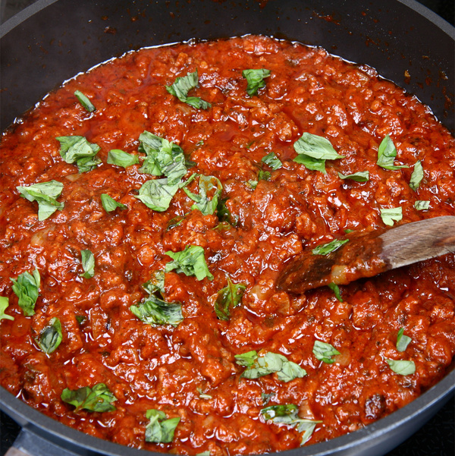
Bolognese Sauce
(extra vegetables)
Method
Collect equipment
Peel and chop the onion and pepper demonstrating the bridge and claw knife skills.
Wash and slice the mushrooms and courgette(or grate carrot)
Turn on the hob. Cook the mince until brown.
Add the onion courgette (or carrot) and mushrooms. Cook for 5 mins.
Add the tomatoes and stock cube.
Add ¼ pint cold water.
Bring to the boil then turn the heat down to simmer.
Simmer for 20 mins. Stir.
Transfer to your container and leave to cool. Add your name and group to your label.
Wash up.
Recipe
1 onion
100g/40z mushrooms
250g/1/2 lb minced beef
1large can chopped tomatoes
1 stock cube
1 garlic clove
1 small courgette or carrot
1 tsp mixed herbs
Equipment
Chopping board
Vegetable knife
wok
Wooden spoon
Measuring jug
Container & name label
Your Bolognese sauce must be completed by…

