Slide 1
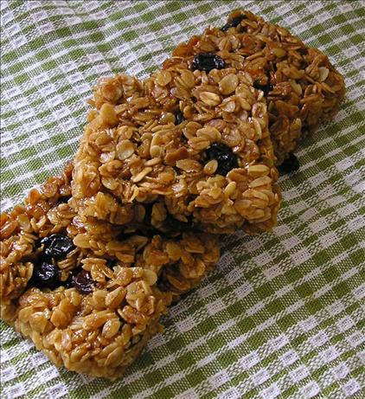
Flapjacks
Method
Collect equipment.
Turn oven on to 160c/Gas 5.
Grease and line the tin.
Put the butter, sugar, cocoa and syrup into a saucepan.
Place the saucepan on the hob and melt the ingredients over a low heat – stir with a wooden spoon until you have a liquid.
Take the pan off the hob and add the oats and raisins to the pan.
Stir until everything is combined.
Press the mixture into the bottom of tin in an even layer
Bake for 25 minutes.
Wash up.
Recipe
200g/8oz porridge oats
100g/4oz butter
50g/2oz sugar
4tbsp golden syrup
Box to carry home in
CHOCOLATE AND RAISIN FLAPJACKS
METHOD Making Date
Collect equipment.
Turn oven on to 160c/Gas 5.
Grease and line the tin.
Put the butter, sugar, cocoa and syrup into a saucepan.
Place the saucepan on the hob and melt the ingredients over a
low heat – stir with a wooden spoon until you have a liquid.
Take the pan off the hob and add the oats and raisins to the pan.
Stir until everything is combined.
Bake for 25 minutes.
Wash up.
Equipment
Wooden spoon
Tablespoon
Saucepan
Large mixing bowl
Small square/round cake tin
Dietary Information
Swap the butter for dairy free butter
Swap the porridge oats for gluten free oats

