Slide 1
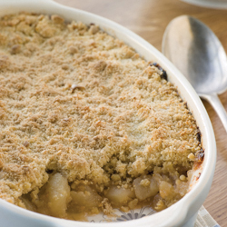
Fruit crumble
Rubbing in method
Method
Turn oven on to Gas4/180°C.
Collect equipment.
Put flour into mixing bowl and add butter.
Cut butter into small pieces.
Rub the butter into the flour using fingertips.
Stir in the sugar and oats, mix with a table knife.
Place the fruit in the dish.
Spoon the topping over the apples in an even layer.
Bake for 20mins in total.
Wash up.
Recipe
Stewed fruit
Topping
150g/6oz plain white flour
75g/3oz butter
75g/3oz sugar
3tbsp rolled porridge oats
Plus oven proof dish from home
Equipment to get out at school
Oven proof dish
Oven gloves
Large mixing bowl
Vegetable knife
Chopping board
Tablespoon
Table knife

