Slide 1
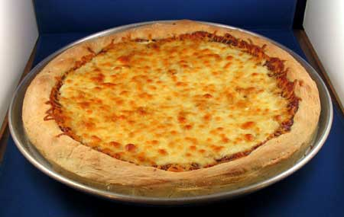
Learning objective.
Today we are learning… to shape a dough
so that… we can make the pizza.
Making date: ___________
Cheese and Tomato Pizza
Method
Collect equipment.
Lightly grease baking sheet.
Light oven 200°C or gas mark 6.
Put the flour and yeast into the mixing bowl.
Add the ¼ pint of water to the flour and mix with a knife to form dough.
Lightly grease the baking tray. Place the dough onto the tray.
Press the dough with the palm of your hand to make it into a base.
Use the same measuring jug to mix 2 tablespoons tomato puree with 2 tablespoons of water.
Spread the tomato puree mixture over the base using the back of a table spoon.
Sprinkle the cheese and herbs on top.
Bake for 10-15mins.
Wash up.
Recipe
For the base:
200g (8oz) Self raising flour
1 teaspoon of yeast (from school)
¼ pint water (from school)
For the topping:
2 tbsp tomato puree
2 tbsp water (from school)
100g (4oz) grated cheese
1 tsp dried herbs
LARGE FOIL PLATE OR BAKING TRAY from home
Equipment
Mixing bowl
Flour dredger
Table knife
Sieve
Pastry cutter
Baking sheet
White tray to put ingredients on
Washing up bowl + squirt of liquid
Dish cloth & tea towel
Food Facts
Do not over handle the dough otherwise it will become tough.
Sour milk can be used as the acidity helps to release the rising agent from the baking powder
At Home
What do you think of the texture of the scones? What other flavouring ingredients could you add?
Take Home Tips
Allow the scones to cool before storing, to avoid condensation making them soggy. Eat on the same day. The low fat content means they go stale quite quickly.
Dietary Information
Swap the cheese for dairy free cheese
Swap the flour for gluten free flour

