Slide 1
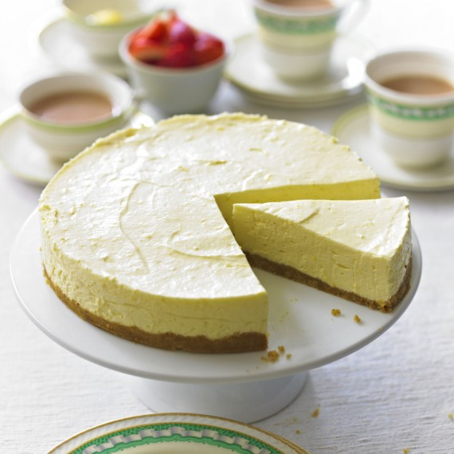
Lemon Cheese Cake
Method
Collect equipment.
Put the biscuits in a bag and crush using a rolling pin.
Put the butter into the pan and melt over a gentle heat.
Take the pan off the hob and stir the biscuits into the butter.
Press the biscuit mixture into the base of the dish.
Whisk the cream in the large bowl until just thick.
Mix the cheese, lemon and sugar together in a small bowl.
Stir the cheese mixture into the cream.
Gently spread over the biscuits.
Cover with cling film and chill
Wash up.
Recipe
150g/6oz Digestive biscuits
75g/3oz butter or margarine
225g/9oz ricotta or mascarpone cheese (or vegan cream cheese)
125ml/¼ pint fresh double or whipping cream (or vegan cream)
50g/2oz caster sugar
1 lemon
Equipment
Mixing bowl
Small bowl
Rolling pin
Spatula
Whisk
Wooden spoon
saucepan
Large container to take home

