Slide 1
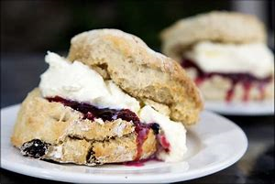
Learning objective.
Today we are learning… the skill of mixing and shaping dough
so that… we can accurately and consistently form dough
Making date: ___________
Scones
Recipe
225g (8oz) Self raising flour
Pinch of salt
50g (2oz) hard margarine/butter/dairy free butter
150ml (1/4 pint) milk
25g caster sugar
50g flavouring eg cherries or raisins
Container to carry home in
Method
Collect equipment.
Lightly flour a baking sheet.
Light oven 220C or gas mark 8.
Sift flour and salt into a bowl and rub in butter/margarine until it resembles breadcrumbs.
Stir the flavouring into the mixture
GRADUALLY add the milk and mix with a table knife to make a soft dough. You might not need to add all the milk.
Turn out onto a lightly floured surface and pat the dough until it is as thick as the pastry cutter. Cut out scone shapes.
Space onto baking sheet.
Bake for 15 minutes until golden brown. Cool on a rack
Wash up
Equipment to get out at school
Equipment to get out at school
Mixing bowl
Flour dredger
Table knife
Sieve
Pastry cutter
Baking sheet
Food Facts
Do not over handle the dough otherwise it will become tough.
Sour milk can be used as the acidity helps to release the rising agent from the baking powder
Dietary Information
Swap the flour for gluten free flour
Swap butter for dairy free

