Slide 1
English Transition Bridging Unit
We would like you to complete two writing challenges that show off your skills in English:
Writing a Formal Letter &
The 200 Word Challenge
The best ones will then be put on display in the English corridor ready for you to show off to your new classmates in September!
Miss Wild (in charge of Year 7 English) is going to share a range of examples which really impress the English Department on the @PHS_EngDept Twitter page.
You can then choose your favourite piece of writing to submit into Google Classroom to represent your school in our transition writing competition!

Slide 2
English Transition Bridging Unit
ALL OF YOUR ENTRIES NEED TO BE HANDWRITTEN
Pick your favourite two pieces of writing for your class teacher to pass on to us at PHS. We will be using these in English lessons in your first term!

Slide 3
Formal Letter
Nomination Letter
Imagine a local newspaper is running a competition to find the Superhero of Year 6 Summer Term. The past year has been a challenging time for many; think carefully who your chosen person might be, and three good reasons why you feel they deserve this award. Write your letter outlining who you would like to nominate and why.

Slide 4
1
Formal Letter
Formal Letter Checklist:
Formal letter layout;
Formal vocabulary;
Organised paragraphs;
Range of punctuation used accurately;
Spelling accuracy;
Interesting content.
Try to include an introduction, three main paragraphs and a concluding paragraph.
This piece of writing will be super useful in Term 1 of Year 7; it will help showcase and develop the skills you will use for your very first writing assessment!

Slide 5
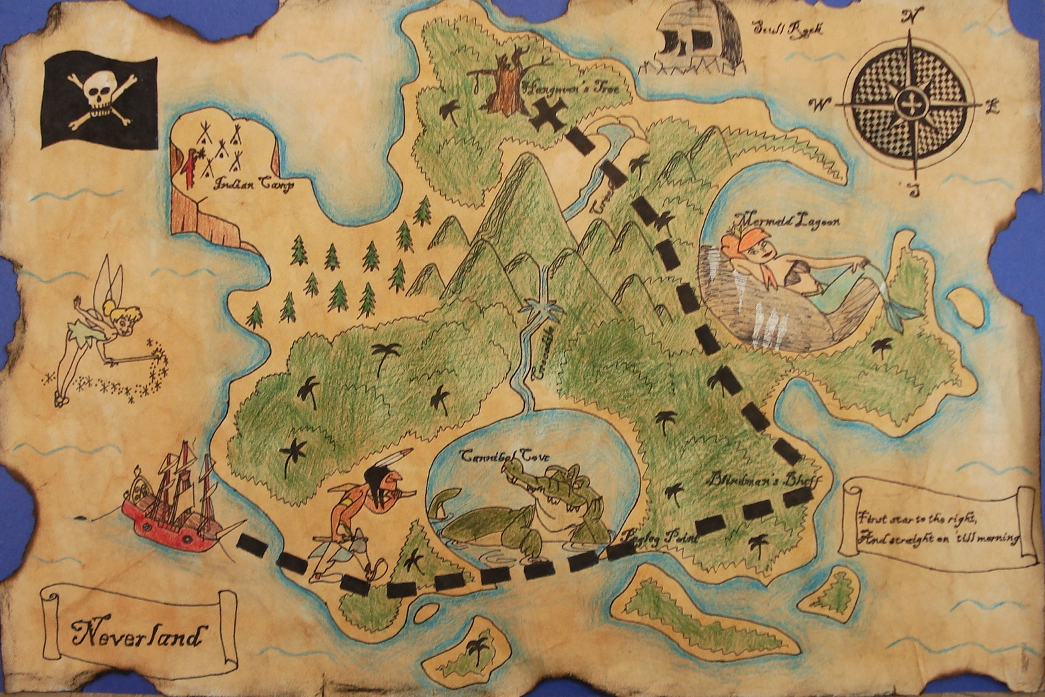
PHS 200 Word Challenge
Whilst searching through an old box you found at home, you discover a treasure map which says that a cursed pirate treasure chest is buried in your garden.
Write what happened in your search for the treasure in no more than 200 words

Slide 6
You are trapped inside your favourite book. Describe your experience in 200 words.

Slide 7
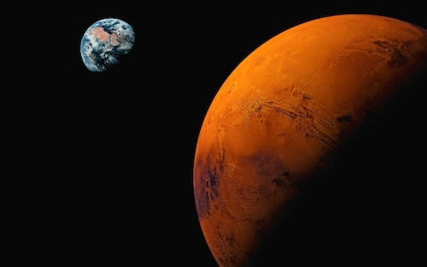
Scientists have just found out that it is possible to live on mars, create a ‘for’ or ‘against’ debate on why you would live there and why you wouldn't.

Slide 8
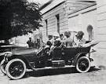
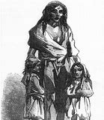
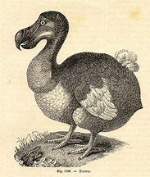
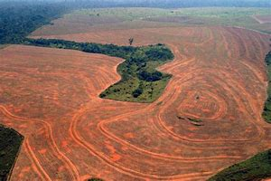
You have a chance to change history. What would you do? Write a description and an explanation in 200 words.

Slide 9
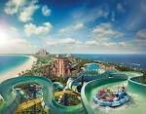
You have just set up your own theme park and it’s opening day! Create an advertising leaflet trying to get people through the gates.

Slide 10
You are being interviewed for a secret spy agency. In 200 Words: write about the interview and whether or not you get the job.

Slide 11
Story Starters
I am in all truthfulness attempting to be cheerful about this whole topic…
Emma stepped down from the yellow school bus and looked around the parking lot…
There is one mirror in my house. It is behind a sliding panel in the hallway upstairs…
When I wake up, the other side of the bed is cold…
Wouldn’t it be nice to know exactly what people are thinking?...
Create a 15 sentence story opening using one of the sentences above.
You must include 12 full stops, a question mark and 2 exclamation marks!

